Slide 1
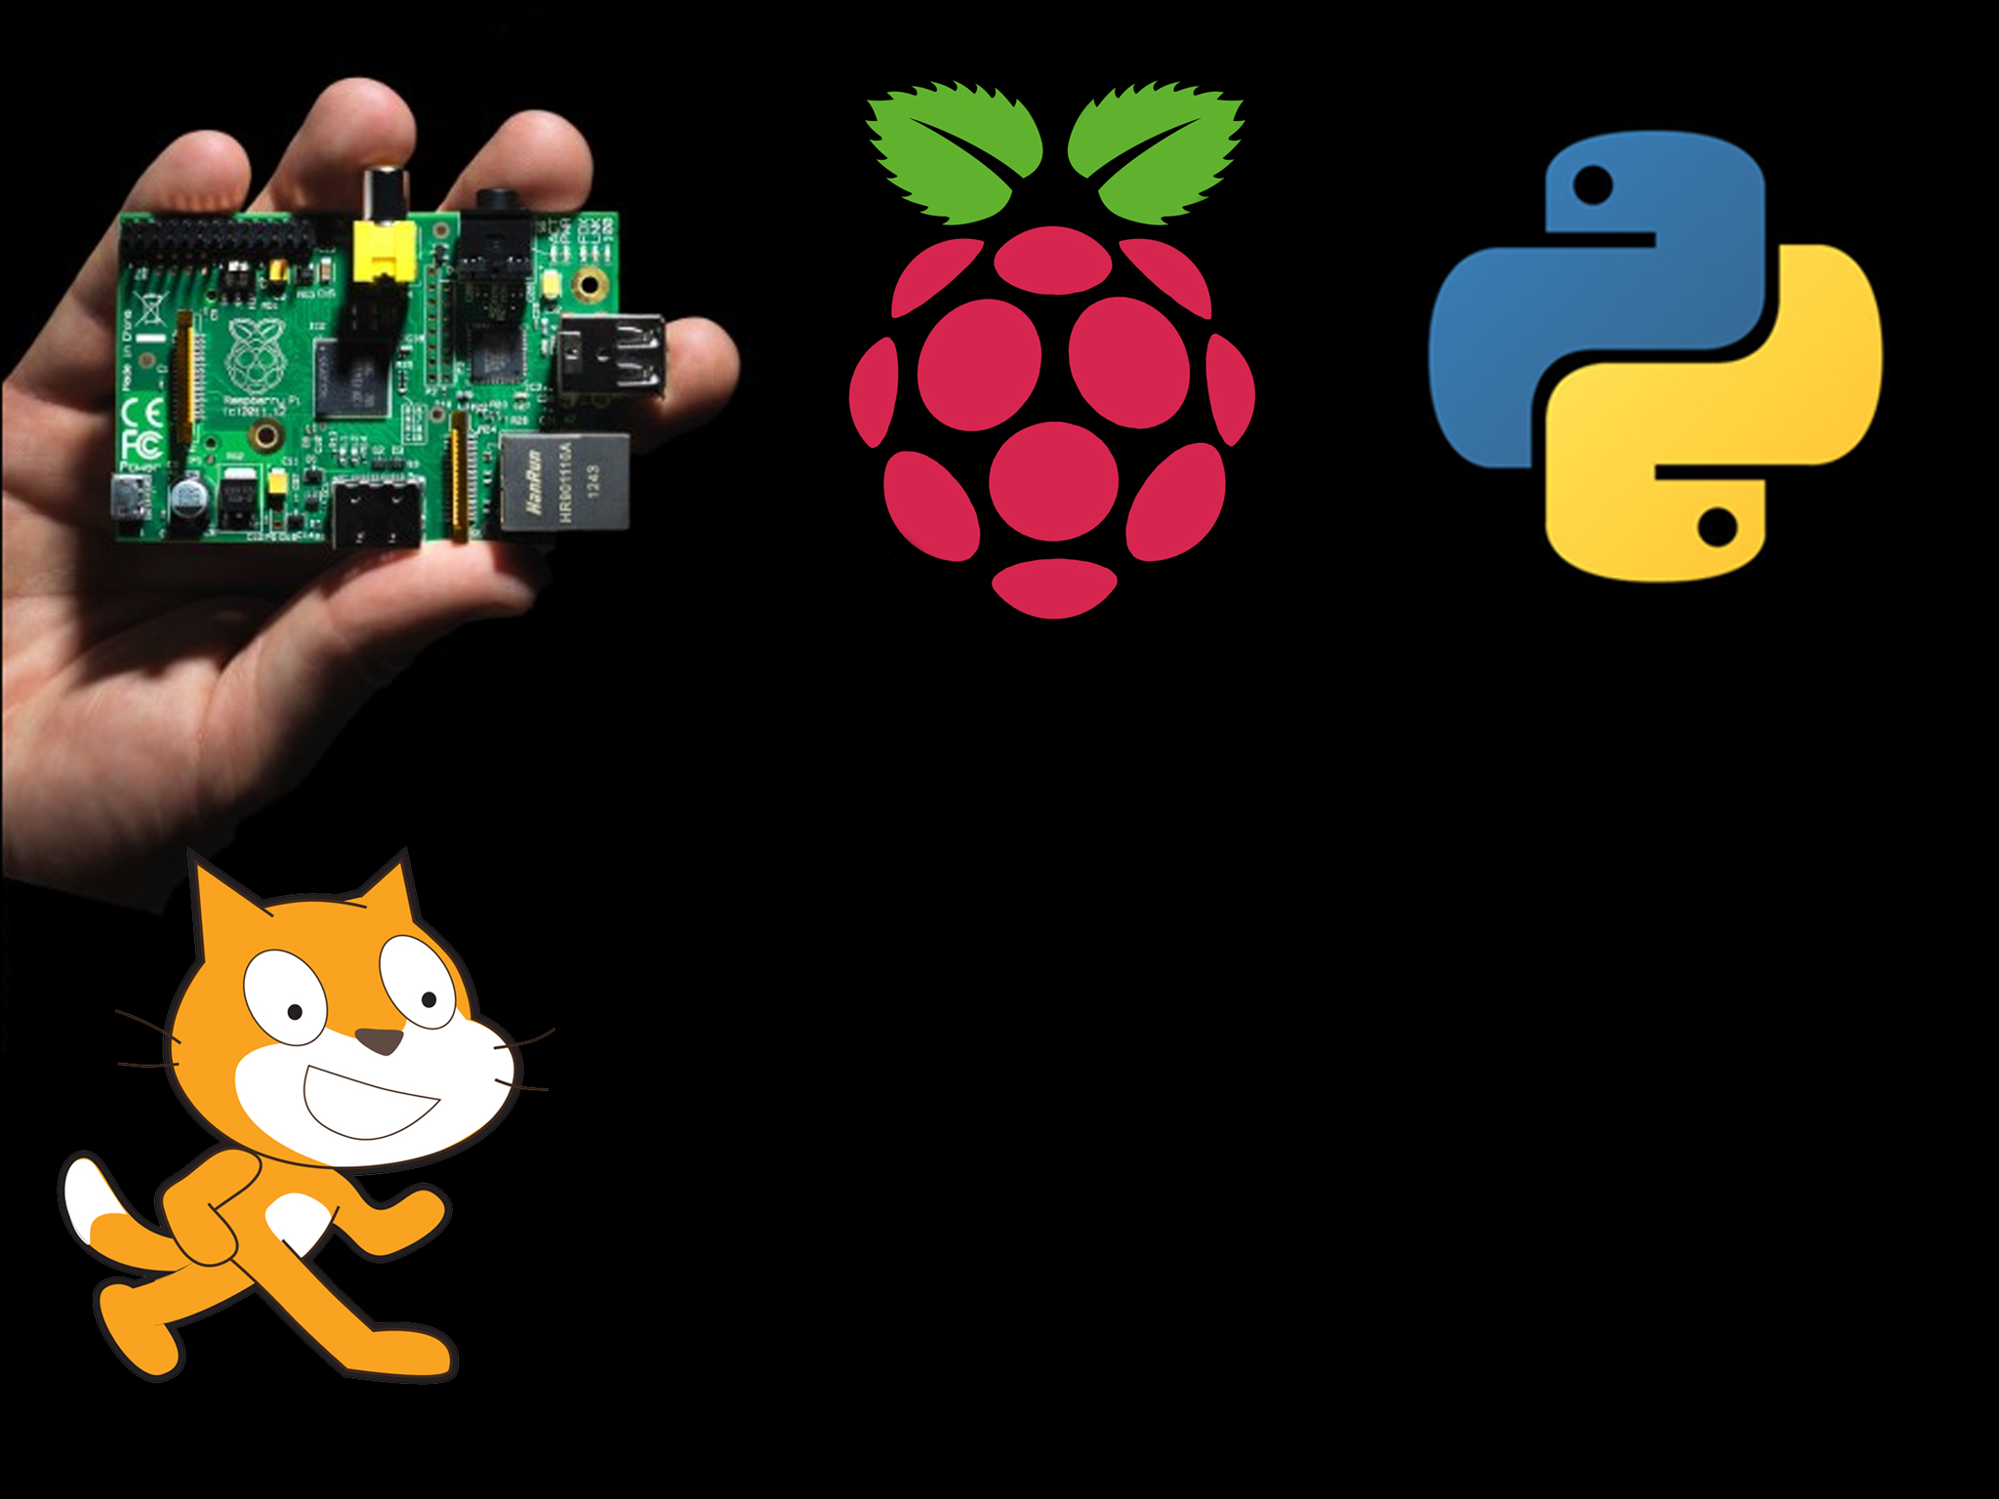
Python
Notes:
Ask what programming languages they have heard of
Ask what they know about python or have ever heard of it

Slide 2
So what do you know about python?
Notes:
Ask them what they know about python, have they ever heard of it?

Slide 3
So what is python?
Python is a computer programming language developed in 1991 by a guy called Guido van Rossum – A Dutch computer programmer
It is designed to be easy to read, but very powerful
There are 2 versions
  2.7
  3.3

Slide 4
So what is python?
We will be using 3.3
2.7 and 3+ are incompatible and don’t work together!
Python is free and open source.
Python runs on Windows, Mac and Linux (Raspberry pi runs Linux)
We will be using a special text editor to write our python code and it is called….
What is …
Open source
All the source code for the piece of software is freely available for you to go and learn from
What is …
Source code
The original code that the program is written in. When it is converted to a computer program, it is hard to get it back to its source code

Slide 5
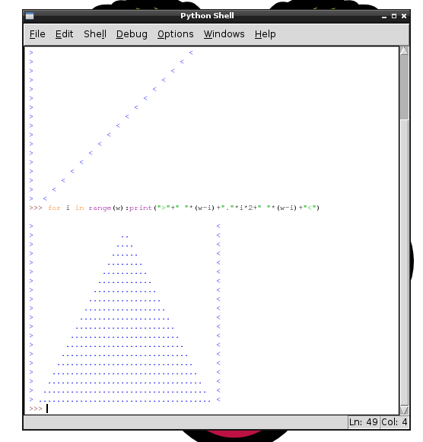
IDLE
IDLE stands for Integrated DeveLopment Environment.
We use it to write our code in
It has syntax highlighting for python
It is FREE!
What is …
Syntax highlighting
Changes specific parts of code to different colours depending what they do. Makes it much easier to read.
Notes:
Explain they can easily install python at home for free and it will always be free

Slide 6
Tea Break
How much does python cost?
What is “source code”?
What does “open source” mean?
It was designed to be……..
If I want to write python code, what program could I use?

Slide 7

Shall we get started?
Open IDLE3 (not IDLE)
Lets get the computer to talk to us. The command to do this is print.
In python, if you want to use words you must put them inside apostrophes or ‘
So to give it the word hello you must do ‘hello’
Enter print(‘Hello’) and see what happens

Slide 8
Print!
Print is used to output information to the console, the thing you are currently using. It can be used to build sentences or just talk to your user. As with all python functions, it must have brackets
E.g. print(‘Hello world’)
Task
1.Printerer
Make the computer print out 5 different sentences
Notes:
Allow maybe 5 mins max for this, try not to bore pupils

Slide 9
Script
The console is great, but what if we wanted to combine a whole pile of commands to run one after each other.
Introducing a script! A script lets you save a list of instructions for the computer to execute one after another.
To make a script in IDLE, hit file and new window. Now enter all your python commands in the script, save it and hit f5 to run it.
Task
2.Printerer part 2
Make the computer print out 5 different sentences using a script
Notes:
Can skip this exercise

Slide 10
Variables
What if I want to store a number? Or maybe a word? I use a variable.
A variable is like a man holding a bucket.
  I can give the man a number and he will put it in the bucket.
  I can ask the man what is in the bucket and he will tell me
  I can ask the man to completely empty the bucket

Slide 11
Variables
In python, we just tell the computer that a variable name = something
For example age = 6 or name = ‘bob’
Or we could bring some maths in age = 6*2
We can ask the computer what is in age entering just age
We can also just do print(age)
Task
3.Quite variable
Make age = 5 then print that, then make the computer multiple age by 2 and print it
Notes:
Go slow on this one, variables are very very important. Don’t rush it

Slide 12

Mistake
All programmers make mistakes, even the most experienced make many mistakes every day.
Python is great at helping you out when you make a mistake though
Try out entering prin(‘hello’)
Python has given us a hint. It is saying prin is not defined which means it does not have prin in its internal dictionary
Notes:
Yes, they are meant to get an error, if they don’t, they did it wrong

Slide 13
Tea Break
I want the computer to write out on screen this Which do I use?
  Write(‘Hello world’)
  Print(‘Hello world’)
  Print(Hello world)
I want to combine lots of commands, I should use a……
What is a variable?

Slide 14
Feeding computer information
A computer game would not be much fun if we could not feed the computer information. For example, enter our name.
In python this is really easy, put input() into a variable
E.g. myname = input()
Task
4.Computer feeding part 1
Ask for the users name, then print hello and then their name on the next line
Notes:
REALLY IMPORTANT – Make sure raw_input() has the open close brackets, it MUST have them!!!

Slide 15
Combining words
In the last task, we wanted to tell the user their name. We had to do it on 2 lines though.
We can combine sets of words into one long string of letters. This is called consecrating.
To do it we just use a + between what we want to combine.
E.g. print(‘hello there ‘ + username)
Task
5.Computer feeding part 2
Ask for the users name, then print hello and then their name on the same line.

Slide 16
Datatypes
In computer programming languages there are things called datatypes. These are simply what type is the data? You will only be working with
  String – A string is a word or words. You can’t do math’s with it
  Integer – An integer is a whole number, you can do math's with it!
Python is able to detect which one you are using normally by how you give it the data. For example
  Example = ‘1’ This will be a string as it is in ‘’
  Example = 1 This will be an integer, we can do math’s with it!
We can convert between them with
  str(example) to convert to a string
  int(example) to convert to an integer
Notes:
This slide can be done at any time throughout the lesson, does not have to be done now

Slide 17

Tea Break
Is this a string or an integer? ‘1’
What is an integer?
How can I combine 2 strings together in python?
Program time
1. Hello user
Ask the user what their name is.
Reply back with “Hello” username
Ask them what their favourite colour is.
Reply back “Well my favourite colour is” colourname “too”
Notes:
A purple program is designed to be a brief. Stress to pupils it must be followed exactly, it is like a job from a big company, it has to be perfect

Slide 18
Only If
One of the most powerful things a computer can do is compare stuff normally returning a True or False.
For logic statements we need to know 2 important symbols
  < This means less than, is the object on the left less is than the object on the right
  > This means more than, is the object on the left is more than the object on the right

Slide 19

If
Why don’t you type in 3 < 5 It should return true as 3 is less than 5
We also have == which means is equal to. Try out 5 == 5 and it should return True.
It also works with variables username = “bob”
What if we wanted to do one thing if the user entered bob but something else if they entered anything else?
We use an if! We use if username == ‘bob’:
We then enter what we want it to do on the next line indented
Notes:
Stress that indentation is very important.
Also make sure to do the 5 == 5 example with them, try it with different numbers and variables

Slide 20

Else
The last bit in this section we need to talk about is else
Else means “I will happen if all else fails”
Else is not indented and must be written like else: (The colon at the end is very important)
Notes:
Remind them else needs a : after it

Slide 21
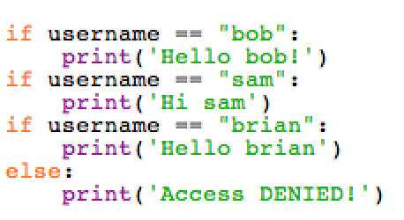
Lots of ifs
So, you want to allow lots of different ifs one after each other. You could just do
Can anyone see a problem with this?
Notes:
Why is this bad??? Ask them!

Slide 22
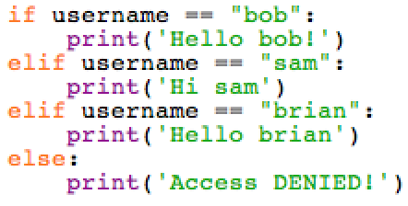
Lots of ifs
It is much smarter in a situation like this to use elif, it is else and if combined but you can also use else at the end!
Notes:
Explain using the example that if they enter bob it will say
Hello bob
Access denied
But with elif it is all part of 1 statement

Slide 23


Program time
2. Number guess
Ask player one to enter a number between 1 and 5
Player 2 then has one guess to guess the number.
You might want to cover over where you entered the number so player 2 can’t see it.
If they enter the correct answer it should output “Good job, you win”
If they enter an incorrect answer it should output “Too bad, you loose, the number was “ number
Save your program as numberguess1.py
Tip
You will need to use if and else in this program, remember your :
Notes:
Again, stress that the program making instructions must be exactly followed

Slide 24
LOOPS!
Loops allow us to repeat bits of code more than once if we want to.
They are much more efficient than copy and pasting the code multiple times
There are 2 main types

Slide 25
For
A “For” loop is used when we know how many times we want to repeat the loop from the first time we go through it.
It automatically iterates through the values provided.
First, how does it know what to iterate through?
What is …
Iterating
Iterating is when you increase a variable 1 by 1 up.
For example
1, 2, 3, 4 etc

Slide 26
For
Type into the python shell
range(0, 10)
It provides us a list of values for us to iterate through.
To create our first for loop, use
for count in range(0, 10):
That will add 1 to count each time the loop starts.
Task
6. SPAM!
Spam 100 lines of what ever you want! No rude things please ☺
Notes:
Get them to try things like range(0,100) or higher, don’t go too high though!

Slide 27
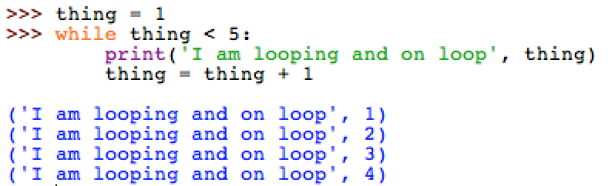
While
A while loop is used to repeat while something is True. In python this is done with
while thing < 5: or maybe while bob == 1:
Task
7. Password time
Create a simple program that loops while the user has not entered the correct password. If they don’t enter the correct password, get it to ask them again

Slide 28
Subroutines
Subroutines are sub routines.
A routine is a special word for a set of instructions.
So a subroutine is a mini collection of instructions inside your main program
But why????

Slide 29
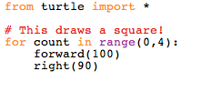
Subroutines
They allow us to easily run a block of code more than once from anywhere in the program.
This piece of code below is very handy, it is for drawing a square. What if we want to draw multiple squares throughout the program? We could copy and paste the code?

Slide 30


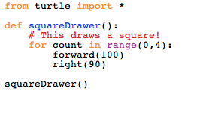

Subroutines
There is a better way!
Defines a new subroutine
All code you want in this subroutine gets indented by another level
Whenever you want to draw the square, you just use its name

Slide 31
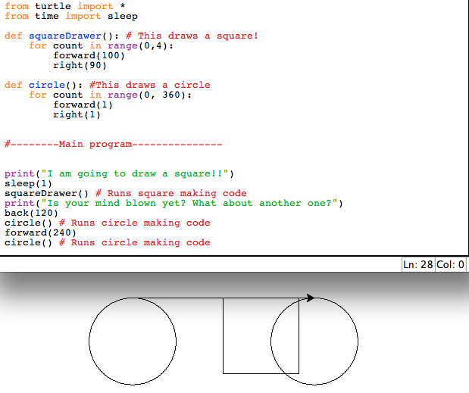
Example
What is happening here?
Notes:
Ask students what is happening in the program.
Then explain that the 2 subroutines are defined at the start and can be called from anywhere in the program and can be called multiple times.
Use explanation that the program jumps about no longer running from top to bottom

Slide 32
Types of subroutines
There are 2 types of subroutines
  Procedures – I don’t return anything back
  Functions – I do! I can give you something back
Normally we use procedures unless we need to return a “thing”
Why would we need to return something?

Slide 33
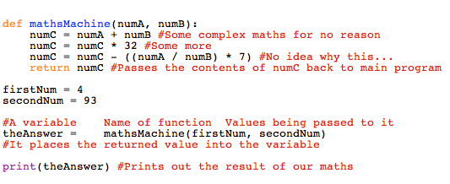
Types of subroutines
Here is a simple example of a function
Notes:
Run through the example with pupils, line by line
Go slow on this one, explain it

Slide 34


Program time
3. Password door
Ask the user “Please enter your password”
If they correctly enter their password, greet them with a message
If they get the wrong password, ask them to enter it again, the program should not end till user has entered correct password
Save your program as Password1.py
Extra activity
Why not support more than 1 password, maybe with different welcome messages?
Perhaps try adding usernames too? (Complicated)
Notes:
Main task should take anywhere from 10 mins to 25 mins, do not proceed till every pupil has completed at least the basic task 3. Let faster students do the extra activity

Slide 35
Modules
You will have seen in multiple examples that we use the command import a lot.
Import allows us to make use of commands that are not part of the base set of commands
If python auto imported every possible command it would be slow… Very slow….
Python was designed to let us pick which bits we want so we can leave out the stuff we don’t need

Slide 36
Modules
The most common import used is for time
By default python has no wait/sleep/pause command built in, you have to import it
In python we use sleep(1) to wait for 1 second
We have 2 choices on how to do this
  Import the entire time library sleep() is from
  Import just sleep()
Notes:
Ask the pupils, which one is a better idea

Slide 37
Modules
Because we rarely use other commands in the time library, normally we use
from time import sleep
This will only import the sleep command into python’s internal dictionary, it wont need to worry about all the other commands in time.
This method is much more efficient than importing the entire library
Notes:
Make sure to mention though importing an entire library can be helpful if using more than 1 or 2 commands

Slide 38
Want to do some more?
We have reached the end… ☹
But you want to learn some more python, Right?
Well you are in luck!
One of the best resources for learning programming is Codecademy!
http://www.codecademy.com/

Slide 39
Specific stuff
If you want to learn more a specific function or module, why not check the excellent python manual! It is easy to read and free.
It can be found at
http://docs.python.org/3
Their very good tutorial for getting started can be found at
http://docs.python.org/3/tutorial

